Slide 1
ECM with app model
Name
Title
Company

Slide 2
Agenda
Document management automation
Content types and site columns
Managed Metadata CSOM
Library and list templates with app model

Slide 3















Vision
EXTEND OFFICE EVERYWHERE
CONNECT TO OFFICE 365 SERVICES
BUILD USING AN OPEN PLATFORM
Delve
z
Users and groups
Files
Mail
Calendar
My Apps
Video Portal
Contacts
Office Graph
Presentations
Documents
Spreadsheets
Lync
OneNote
Yammer

Slide 4
Recommendations
Create elements using CSOM, no XML
Taxonomy CSOM is extremely powerful
Remote timer job based governance solutions
Stop using xml list templates
Notes:
Vesa

Slide 5
Managing site columns and content types with app model

Slide 6

Content types and site columns
What
Create site columns and content types to sites using app model techniques
Why
Ensure that required information management architecture exists cross the sites
How
Use remote APIs during site provisioning to ensure that right elements and structures are available for the end users

Slide 7
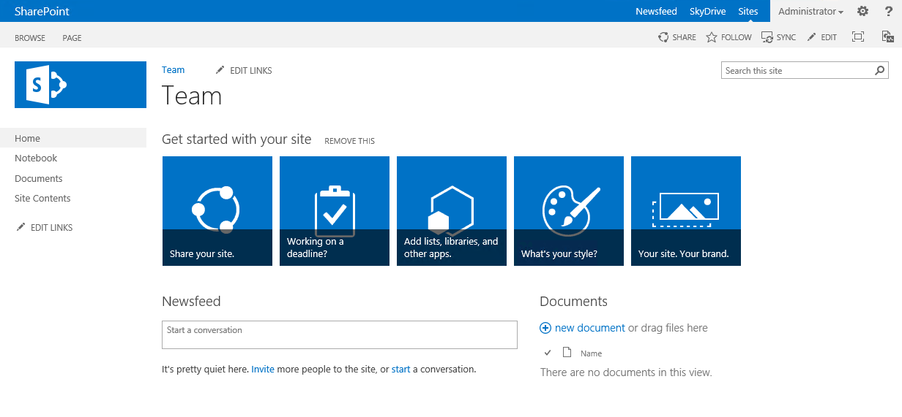
Create site columns and content types
1
Provider Hosted Apps
SharePoint Service
CSOM/REST
3
Creation of site columns
Creation of content types
Create association
Configuration
2

Slide 8
Creating site columns and content types using CSOM
Demo
https://github.com/OfficeDev/PnP/tree/master/Scenarios/ECM.DocumentLibraries

Slide 9
MMS and taxonomy

Slide 10

Managed Metadata CSOM
SharePoint 2013 CSOM has support for taxonomy
Add references to:
Microsoft.SharePoint.Client.dll
Microsoft.SharePoint.Client.Runtime.dll
Microsoft.SharePoint.Client.Taxonomy.dll
CSOM usage is usage very similar to server-side taxonomy API
Obtain TaxonomySession reference followed by
Term Store
Group
Term Set
Terms
Load objects & collections as necessary
Notes:
Title: Managed Metadata CSOM
Length: 1 minute
The ECM client object model is available in .NET Framework libraries (.NET Framework client and Microsoft Silverlight) and JavaScript script files. The client object model enables developers to access metadata and other ECM APIs from the client. This is especially useful in scenarios where reading content is a higher priority than administering it or authoring it, and where SharePoint Server 2013 needs to enable a cloud scenario (SharePoint Online) for a subset of functionality that is available on-premises.

Slide 11
Reference code to connect to taxonomy store
// Open context
ClientContext clientContext = new ClientContext(siteUrl);
TaxonomySession taxonomySession = TaxonomySession.GetTaxonomySession(clientContext);
TermStore termStore = taxonomySession.GetDefaultSiteCollectionTermStore();
// Load the needed data
clientContext.Load(termStore,
store => store.Name,
store => store.Groups.Include(
group => group.Name,
group => group.TermSets.Include(
termSet => termSet.Name,
termSet => termSet.Terms.Include(
term => term.Name)
)
)
);
clientContext.ExecuteQuery();
//
//Writes the taxonomy item names.
//
if (taxonomySession != null)
{
if (termStore != null)
{
foreach (TermGroup group in termStore.Groups)
{
Console.WriteLine("Group " + group.Name);
foreach (TermSet termSet in group.TermSets)
{
Console.WriteLine("TermSet " + termSet.Name);
foreach (Term term in termSet.Terms)
{
//Writes root-level terms only.
Console.WriteLine("Term " + term.Name);
}
}
}
}
}
Notes:
Title: Reference code to connect to taxonomy store
Length: 1 minute

Slide 12
Creating terms to taxonomy store
// Set context
ClientContext clientContext = new ClientContext(“http://teams.contoso.com”);
// Get access to taxonomy CSOM
TaxonomySession taxonomySession = TaxonomySession.GetTaxonomySession(clientContext);
clientContext.Load(taxonomySession);
clientContext.ExecuteQuery();
if (taxonomySession != null)
{
TermStore termStore = taxonomySession.GetDefaultKeywordsTermStore();
//TermStore termStore = taxonomySession.GetDefaultSiteCollectionTermStore();
if (termStore != null)
{
// Create group, termset, and terms.
TermGroup myGroup = termStore.CreateGroup("MyGroup II", Guid.NewGuid());
TermSet myTermSet = myGroup.CreateTermSet("Color", Guid.NewGuid(), 1033);
myTermSet.CreateTerm("Red", 1033, Guid.NewGuid());
myTermSet.CreateTerm("Purple", 1033, Guid.NewGuid());
clientContext.ExecuteQuery();
}
}
Notes:
Title: Creating terms to taxonomy store
Length: 1 minute

Slide 13
Taxonomy CSOM
Demo
https://github.com/OfficeDev/PnP/tree/master/Samples/Core.MMS

Slide 14
Document library templates

Slide 15
List templates with app model
What
Introduce predefined list templates which can be used to provision list instances cross site collection
Why
Provide consistent list instances with the needed document management capabilities cross deployment
How
Use app model to provide similar end user experience as with the list template with feature framework

Slide 16
List templates from apps
1
Provider Hosted Apps
SharePoint Service
CSOM/REST
3
Creation of oob list
Add lists
Add content types and site columns
Add other configurations
Configuration
2

Slide 17
Handling configuration for standard libraries
<< Add List >>
Provider Hosted Apps
1
SharePoint Service
CSOM/REST
3
Creation of oob list
Add lists
Add content types and site columns
Add other configurations
Configuration
2

Slide 18
List templates with apps
Demo
https://github.com/OfficeDev/PnP/tree/master/Scenarios/ECM.DocumentLibraries

Slide 19
Information management policy

Slide 20
Information management policy
What
Perform operations based on document metadata.
Why
Many companies have document management policies to delete or refresh any old documents in the SharePoint. Classically you could also associate workflow or other actions to the operation which is started based on the scheduled check.
How
Use remote timer job pattern to scan documents in the SharePoint based on business requirements.

Slide 21
Remote timer job based policy check
Scheduled execution which accesses the sites and checks the documents based on the business scenario.
Can use either specific account for connection or oAuth based app-only token approach
SharePoint Service
2
Provider Hosted Apps
1
Remote timer job

Slide 22
Auditing settings

Slide 23
Auditing settings with app model
What
Controlling auditing settings cross site collections in SharePoint deployment
Why
Auditing information is often requested to be enabled by the customers cross all sites in the SharePoint.
How
Use new APIs in the CSOM or use new Compliance Center capability in the Office 365 for cross tenant configuration for auditing settings
CSOM API for auditing capability was introduced in 2014 December CU and will be included in cloud CSOM package after that.

Slide 24
Modify auditing settings using CSOM
using (var clientContext = spContext.CreateUserClientContextForSPHost())
{
Microsoft.SharePoint.Client.Site site = clientContext.Site;
Audit audit = site.Audit;
clientContext.Load(site);
clientContext.Load(audit);
clientContext.ExecuteQuery();
// Enable all auditing is site collection level
site.Audit.AuditFlags = Microsoft.SharePoint.Client.AuditMaskType.All;
site.Audit.Update();
// Adjust retention time to be 7 days
site.AuditLogTrimmingRetention = 7;
site.TrimAuditLog = true;
clientContext.ExecuteQuery();
}

Slide 25
Recommendations
Create elements using CSOM, no XML
Taxonomy CSOM is extremely powerful
Remote timer job based governance solutions
Stop using xml list templates
Notes:
Vesa

Slide 26
Questions?

Slide 27

aka.ms/OfficeDevPnP
Transform your code
Providing App Model Patterns for common scenarios Open source and based on community contributions Constantly evolving set of material for reuse
100+ Visual Studio projects
Common scenarios Branding Site provisioning Remote event receivers
UX component Taxonomy driven navigation And much more…
Patterns and Practices Yammer Group - http://aka.ms/officedevpnpYammer

Slide 28
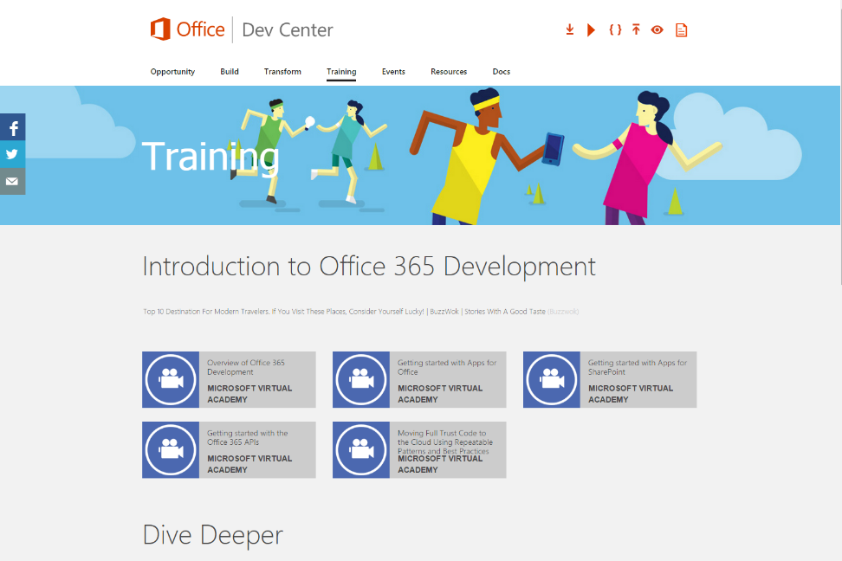
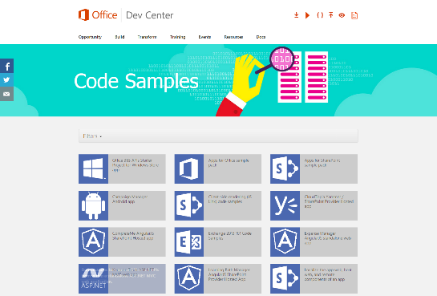
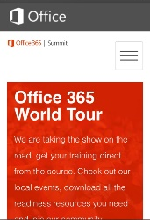
dev.office.com
Sign up
http://dev.office.com/getting-started
Explore
http://apisandbox.msdn.microsoft.com
Get trained http://dev.office.com/training

Slide 29


Feedback
Office 365 Network Share you best practices and join conversations
https://www.yammer.com/itpronetwork
Stackoverflow Ask deep technical questions to a world-wide set of developers
http://stackoverflow.com/questions/tagged/ms-office
UserVoice Provide suggestions of what you want in future versions
http://officespdev.uservoice.com/

Slide 30


© 2015 Microsoft Corporation. All rights reserved. Microsoft, Windows, and other product names are or may be registered trademarks and/or trademarks in the U.S. and/or other countries.
The information herein is for informational purposes only and represents the current view of Microsoft Corporation as of the date of this presentation. Because Microsoft must respond to changing market conditions, it should not be interpreted to be a commitment on the part of Microsoft, and Microsoft cannot guarantee the accuracy of any information provided after the date of this presentation. MICROSOFT MAKES NO WARRANTIES, EXPRESS, IMPLIED OR STATUTORY, AS TO THE INFORMATION IN THIS PRESENTATION.

